Slide 1
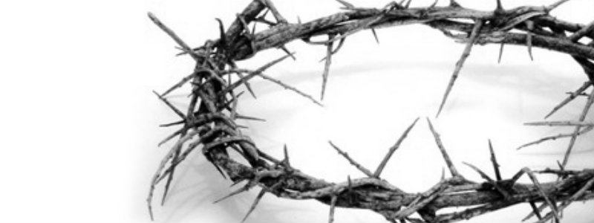
The Nature of the Gospel
68
Soteriology: God's Rescue Program
Dr. Rick Griffith • Jordan Evangelical Theological Seminary • BibleStudyDownloads.org

Slide 2

What would you say?
Write your answer on a piece of paper.
A person was just in a car accident and has only one minute to live. He says to you,
“How can I know if I will go to heaven?”
Notes:
After one minute, collect the papers and read them to the class.
___
From Joseph Dillow, Final Destiny, 32

Slide 3

What is the Gospel that saves us?
68
How do we “contend for the faith that was once for all entrusted to the saints” (Jude 3) if we don't even know what that faith is?
Notes:
NS-26-Jude-21
SA-16-Nature of the Gospel-02

Slide 4
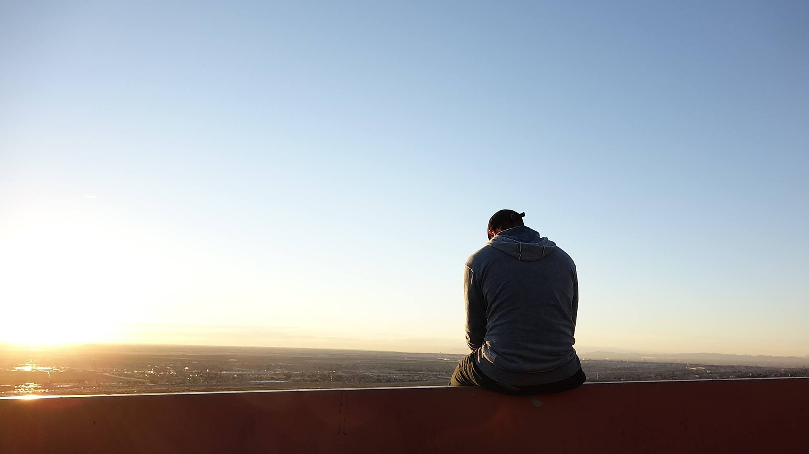
Repentance
What is it?

Slide 5

Repentance
Is it “to turn from sin”?

Slide 6
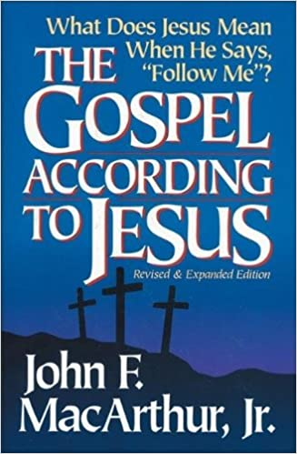
Repentance
“No evangelism that omits the message of repentance can properly be called the gospel, for sinners cannot come to Jesus Christ apart from a radical change of heart, mind, and will.”
John MacArthur, The Gospel According to Jesus (Grand Rapids: Zondervan, 1988), 81

Slide 7

Repentance
“to change the mind” (Greek)

Slide 8
Repentance
It is an “afterthought” or “second opinion.” Charles Ryrie, for example, says, “Repentance means a genuine change of mind that affects the life in some way. Like other significant theological terms it must be defined specifically by asking a further question, namely, change the mind about what? Christians can repent of specific sins and stop doing them (Revelation 2:5; 2 Corinthians 7:9).” Do non-Christians have to repent? Ryrie says yes, if one defines repentance correctly. “Saving repentance,” he says, “has to involve a change of mind about Jesus Christ so that whatever a person thought of Him before, he changes his mind and trusts Him to be his Savior [Basic Theology, 390].” This approach seems quite plausible to me and works in the majority of the passages where repentance is mentioned in the New Testament. —Dillow, Final Destiny, 33

Slide 9
Repentance
The best interpretation of metanoeo in the New Testament is to acknowledge, to change one’s mind about something, to admit, to feel sorry for. A good Old Testament illustration of this usage would be Jeremiah 8:6.
I have listened and heard,
They have spoken what is not right; No man repented of his wickedness, saying, “What have I done?” Everyone turned to his course, like a horse charging into the battle.
—Dillow, Final Destiny, 35
Notes:
Note that “repented” is described as saying “What have I done?” It is an admission of guilt. As a result, they manifested the fruit of repentance and “turned their course.”
—Dillow, 36

Slide 10
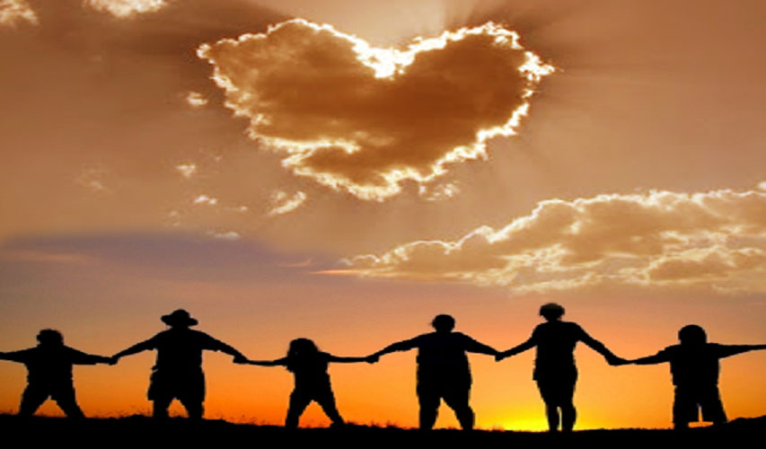
The Gospel
Is it really changing our lives?
Notes:
The gospel is supposed to change lives.
Why doesn't the gospel change our lives like it should?
Too often the lives of Christians isn't really different from the non-believers.
In some situations in the USA, the church has a higher divorce rate than the world!
The way believers spend their money isn't much different either. The average Christian gives about 1-3% of his income, which is about the same as non-Christian giving.

Slide 11
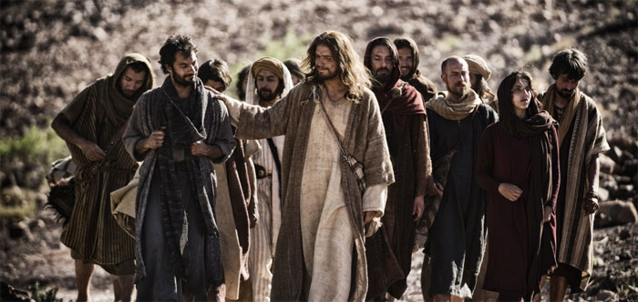
Too often the results of the gospel are confused with the nature of the gospel.
Notes:
Well-meaning believers can confuse simple trust in the message of the cross with the behavioral change the gospel is supposed to make!

Slide 12
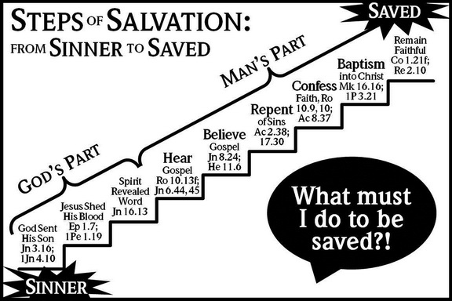
The Problem: A False Gospel Proclaimed
STEPS ^{OF} SALVATION:
SAVED
^{FROM} SINNER ^{TO} SAVED:
Remain Faithful
Col 1:21；
Rev 2:10
MAN'S PART
Baptism into Christ
Mk 16:16
1 Pet 3:21
Confess Faith
Rom 10:9-10；
Acts 8:37
Repent
of Sins
Acts 2:38，
17:30
Believe Gospel
Jn 8:24；
Heb 11:6
GOD'S PART
Hear Gospel
Rom 10:13；Jn 6:44，45
Spirit Revealed Word
Jn 16:13
What must I do to be saved?
Jesus Shed His Blood
Eph 1:7；
1 Pet 1:19
God Sent His Son
Jn 3:16；
1 Jn 4:10
—A Church of Christ view
SINNER
Notes:
NS-26-Jude-24
SA-16-Nature of the Gospel-05
This is the Church of Christ view—But it looks to me like they say we need to do SIX things!
This brings NO assurance in this life as no one ever knows just how much he will “remain faithful”
Five Steps to Salvation
By Allan Stanglin
http://www.allanstanglin.com/five-steps-to-salvation/
24 April 2013
Accessed 9 May 2016
It's just a Church of Christ thing, right? The “Plan of Salvation,” also called the “Five Steps of Salvation,” is unique to us, I think. And those of us who were raised in and by the Churches of Christ know them well: Hear, Believe, Repent, Confess, Baptism. In that order. As a kid in the '70s, this was drilled into me by my Sunday school teachers in Bible class, by the preachers from the pulpits, by the youth ministers at the devotionals and rallies, and by the Open Bible Study my dad walked me through when I reached the “age of accountability.” The five steps were plastered on bulletin boards in the church hallways, illustrated by charts and diagrams on mimeographed handouts, and splashed across banners promoting the next Gospel meeting. These were the five steps, always accompanied by supporting verses of Scripture, that necessarily had to be followed — again, in order! — for one to be saved.
Hear. Believe. Repent. Confess. Be Baptized.
You ever wonder how that started? You ever question the validity of such a list? If you or your church were to make a list of supposed steps to salvation, what would you include? What parts of our CofC list would you leave out?
Historians point back to our movement's focus on rational thought and enlightenment thinking that characterized the mainstream culture of America at the turn of the 19th century when Stone and Campbell and others were attempting to “restore” God's Church. It was all about scientific reasoning and empirical evidence and deductive problem-solving. Society at this time was convinced that there were undeniable patterns, unalterable designs in nature and in the world that, if learned and applied, held the keys to everlasting peace and joy.
Alexander Campbell searched the Scriptures in this way and came up with what he called “the ancient gospel,” a pattern he believed was the divinely-ordained natural way to heaven. According to Campbell, it all boiled down to, in this order: gospel facts (death, burial, resurrection, and ascension of Christ), faith, repentance, reformation (of life), baptism, remission of sins, reception of the Holy Spirit, sanctification, resurrection of the saints, and eternal life. In that order. Campbell claimed that all Christian denominations believed in all these steps, but put them in different orders according to their own interpretations or theories of conversion.
At about the same time, Walter Scott came up with a biblical pattern and called it “the gospel restored.” He had six points originally. The first three were what humans had to do to be saved: believe, repent, and be baptized. The last three were what God promises to people who do the first three: forgiveness of sins, the gift of the Holy Spirit, and eternal life. Not too much later, Scott shortened his list to five points — one for each finger on a person's hand, for easy remembering: faith, repentance, baptism, forgiveness of sin, and the gift of the Holy Spirit.
This method proved to be very successful on the early American frontier where most everybody had been trained in Calvinism which claimed that men and women were saved only by God's predestination, that one couldn't do anything to save himself, it was all up to God's pre-ordained choosing. By telling these fiercely independent early frontier people that there really was something they could do to be saved, the Stone and Campbell churches fueled a massive rush to repentance and baptism.
As with most good things, we swung the pendulum a bit too far. Pretty soon, we were taking God's initiative and the Holy Spirit's active participation clear out of the conversion process. Preaching became all about proving “facts” with arguments and evidence. The Holy Spirit's work in the past had been entered into the Biblical record and was there to be studied in a rational manner, but it wasn't necessary for a person's salvation. The emphasis was on logical fact-finding and step-following and persuading people to “obey the gospel.” The “gospel,” of course, being the steps.
So, at some point in the middle of the 1800s, it gets boiled down to what we have today in the five steps of salvation or the plan of salvation: hear, believe, repent, confess, be baptized. Notice how God's divine activity is completely absent from any of the steps. Notice how this chart here to the right — all of these charts were downloaded from Church of Christ websites this morning — actually gives much more responsibility or credit to man than to God for salvation. Where is God in our “plan of salvation?”
Why is baptism the last step? Who took out “sanctification,” the guiding of the Holy Spirit, and the grace of God to continually wash our sins?
It is God who works to will and to act according to his good purpose. It is God who initiates salvation, who begins the good work and sees it through to completion. Belief and repentance and confession are salvation steps to be taken every day, not once on a ladder list of human accomplishments. Baptism is never the end of what the apostle Paul calls “being saved,” it's the beginning. Our five steps minimize our God. Our five steps neglect a lifetime of day-by-day, hour-by-hour difficult discipleship to Jesus. And they ignore the unmerited and continuous grace of our merciful Father.
OK, maybe that's a little harsh. Too judgmental, probably, Yes, we come by the “five-steps” thing naturally. It's been handed down to us by faithful men and women who were doing their very best with what they had to work with during the times they lived. And I'm grateful for it. Seriously. But I'm also so glad that we've recognized the many shortcomings in this kind of incomplete view of salvation. I'm so glad that we're acknowledging together the active role of God's Spirit in the calling and saving and sanctifying of the saints. And I'm glad we can change. I'm so glad, by God's grace, we're allowed and even compelled to change.
Peace,
Allan

Slide 13
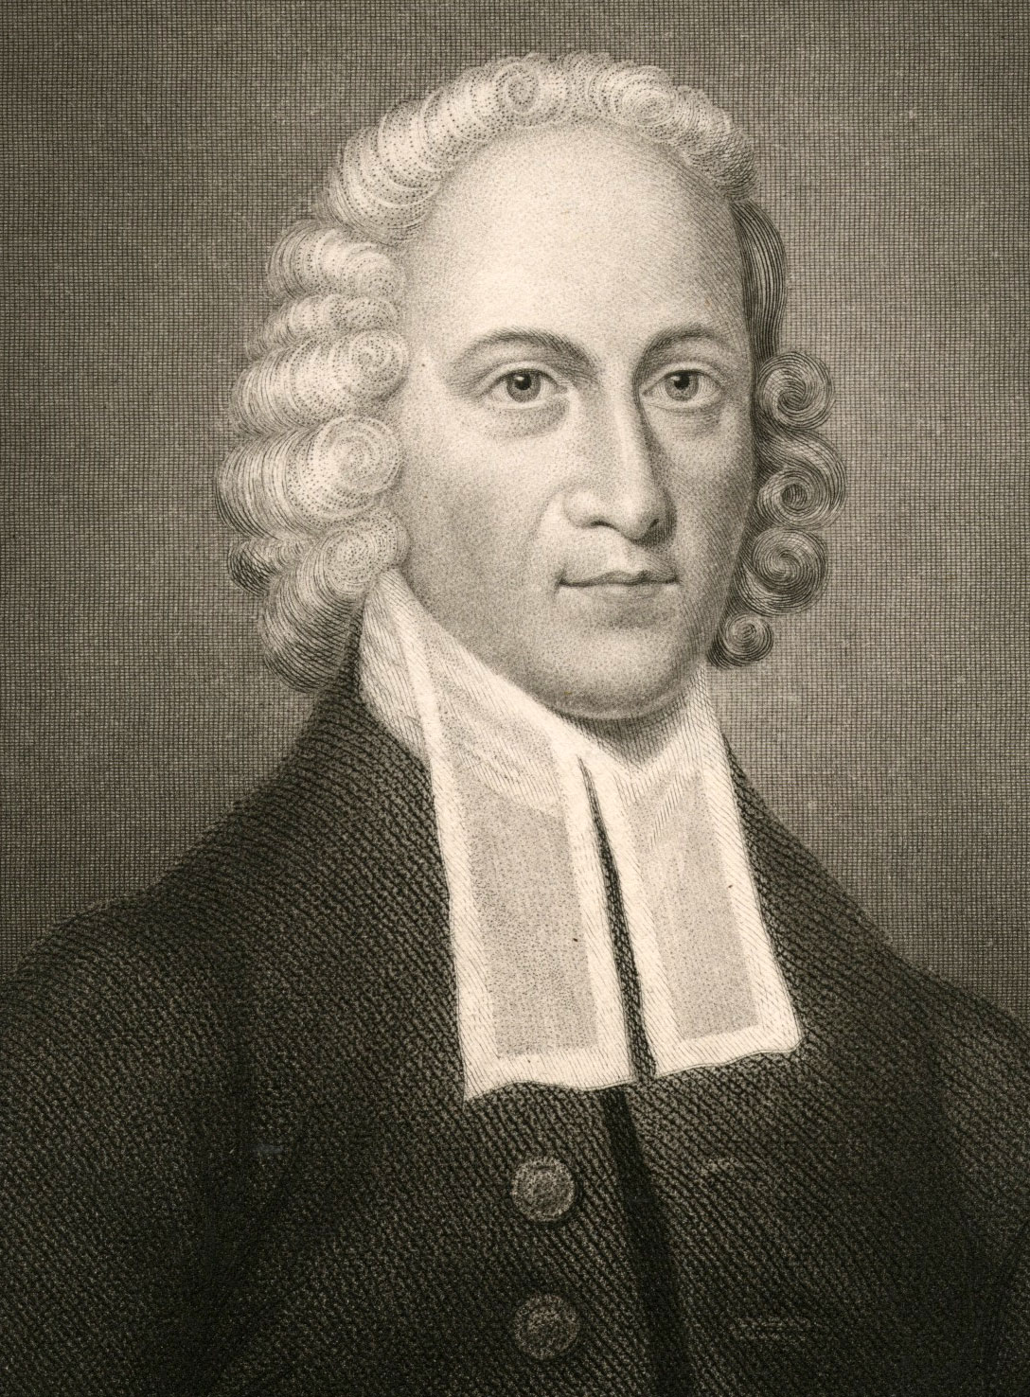
Grace
“You contribute nothing to your salvation except the sin that made it necessary.”
JONATHAN EDWARDS
1703-1758

Slide 14

The Gospel is…
68
GOOD NEWS!
Notes:
NS-26-Jude-25
SA-16-Nature of the Gospel-06

Slide 15
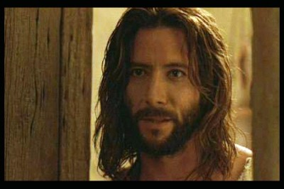
John
68
What must you trust about Jesus to be saved?
Must you add anything to this?
What is saving faith?
How is it different from false faith?
Notes:
If the person next to you was injured and only had a minute or two to live, but asked you, “What must I do to be saved?” what would you say? The shorter one of the two of you is now dying, so the taller one now has one minute to explain the gospel. Go!

Slide 16
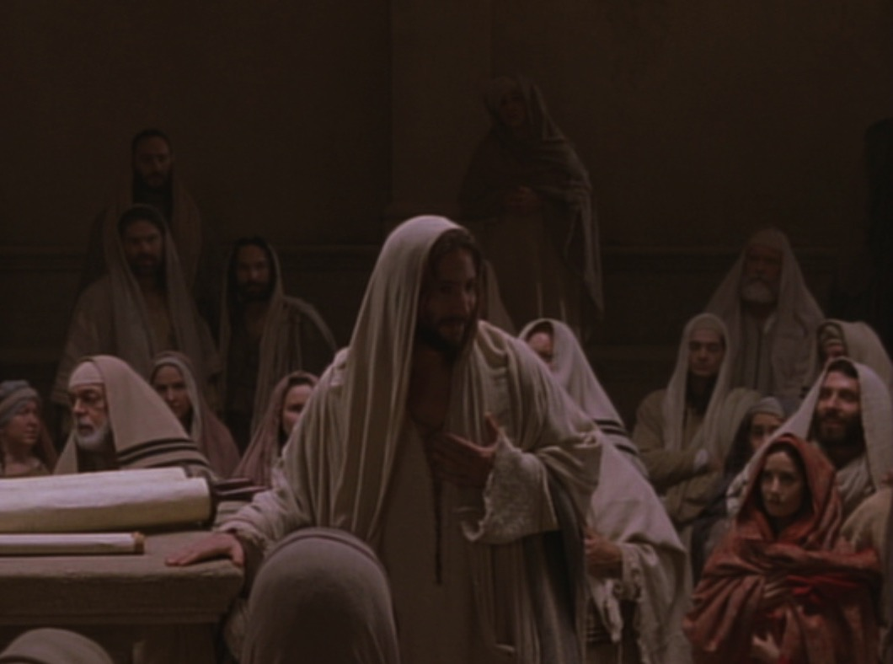
Key Word Believe
John
68
Key Verse
"Jesus did many other miraculous signs in the presence of his disciples, which are not recorded in this book. But these are written that you may believe that Jesus is the Christ, the Son of God, and that by believing
you may have life in his name" (20:30-31).

Slide 17
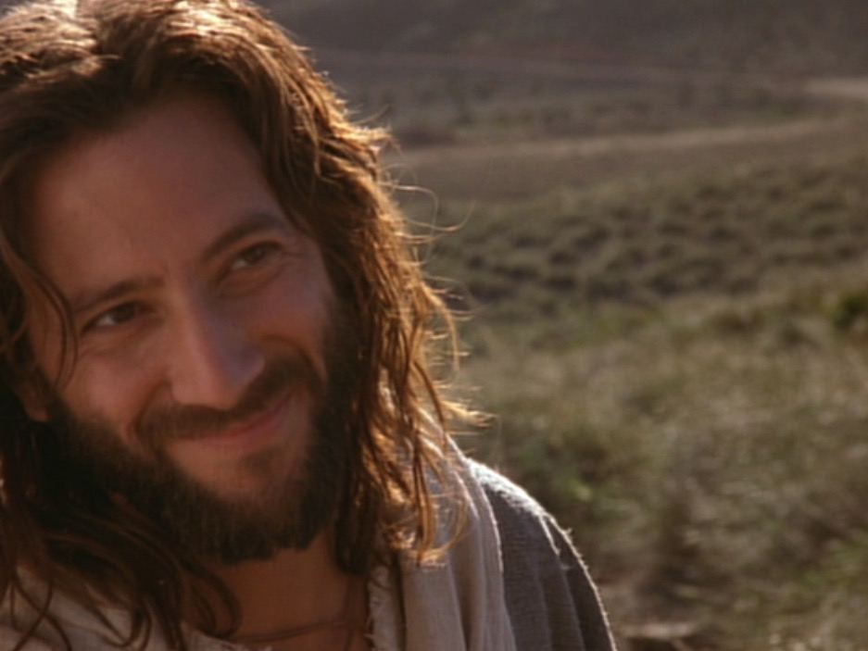
Summary Statement
Gospel of John
68
John proves Jesus to be the Son of God (deity) made man through selected signs and discourses of Christ to convince unbelieving Gentiles to believe in Him and receive eternal life.
Application
Are you 100% sure that you have eternal life by believing in Christ's name?

Slide 18
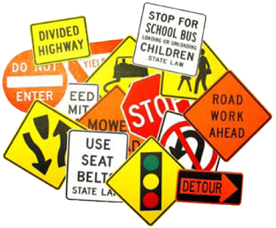

Signs in John's Gospel
68
Signs unique to John's Gospel in yellow (6 of the 9 miracles)
WATER
TO WINE
2:1-11
HEALING
OFFICIAL'S
SON
4:46-54
HEALING
PARALYTIC
5:1-18
FEEDING
5000
6:1-15
WALKING
ON WATER
6:16-24
HEALING
BLIND MAN
9:1-7
RAISING
LAZARUS
11:1-45
CHRIST'S
RESURRECTION
20:1-31
FISH
CATCH
21:1-3

Slide 19

Assurance in 1 John 5:11-13
62 b) (2)
63
63
Should we
ever doubt?
Should we
ever doubt?
Should we
ever doubt?
"And this is what God has testified:
He has given us eternal life, and this life is in his Son. ¹²Whoever has the Son has life; whoever does not have God's Son does not have life. ¹³I have written this to you who believe in the name of the Son of God, so that you may know you have eternal life."

Slide 20
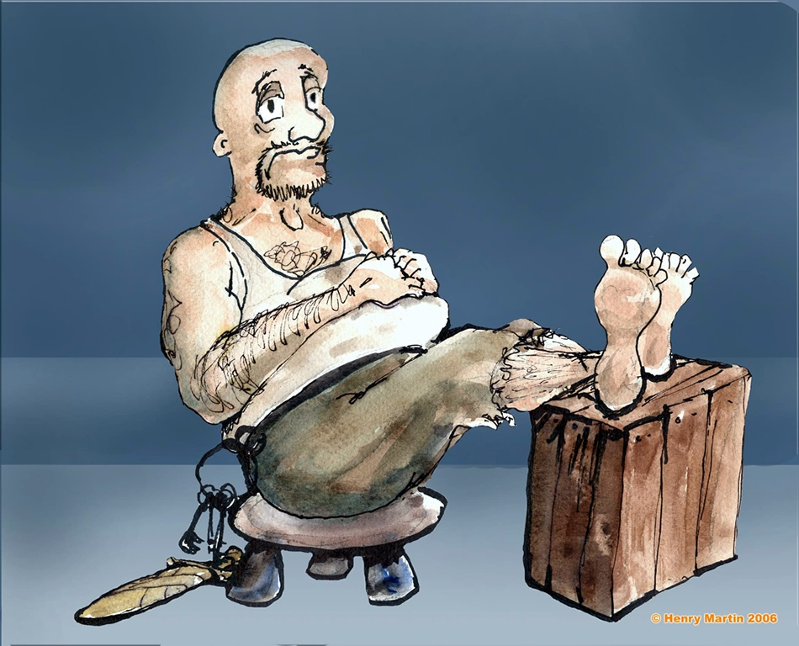
The Philippian Jailor (Acts 16)
Notes:
The jailor was sitting quietly one evening...

Slide 21
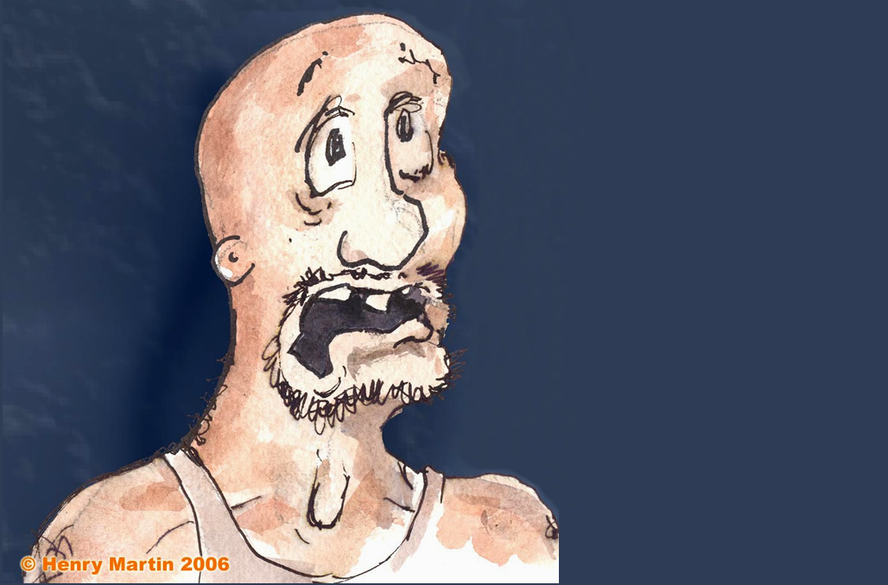
“An earthquake?! Oh, no! The prisoners escaped!”
Notes:
Until suddenly there was an earthquake! Fear seized him…

Slide 22
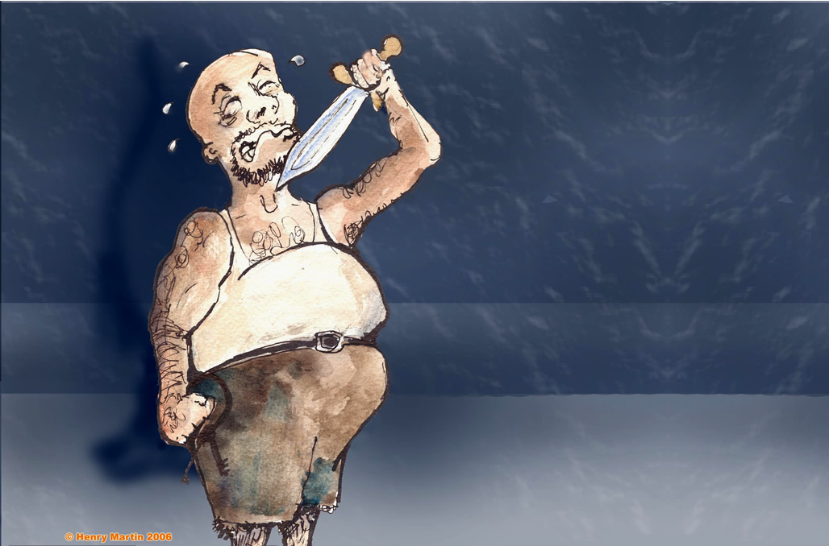
Attempted suicide
Notes:
He thought that Paul and Silas had escaped, so he sought to kill himself

Slide 23
“What must I do to be saved?”
Notes:
Until suddenly there was an earthquake! Fear seized him…

Slide 24
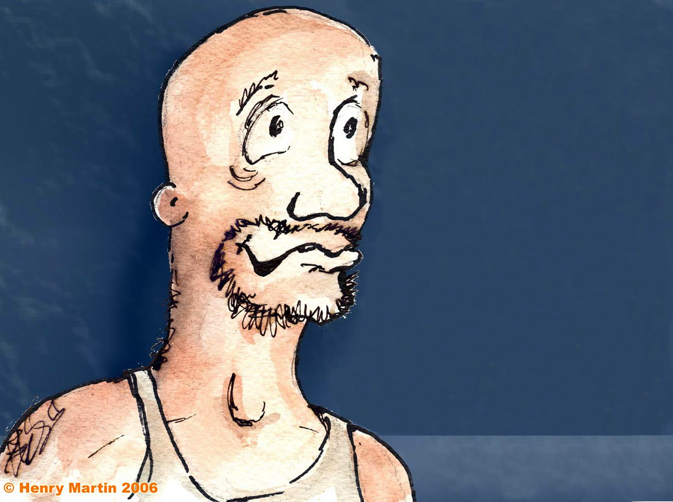
“Believe in the Lord Jesus Christ and you will be saved—you and your entire household!"
(Acts 16:16).
Notes:
But Paul told him, "Believe in the Lord Jesus Christ and you will be saved—you and your entire household!" (Acts 16:16). So he trusted Christ and was filled with joy.

Slide 25
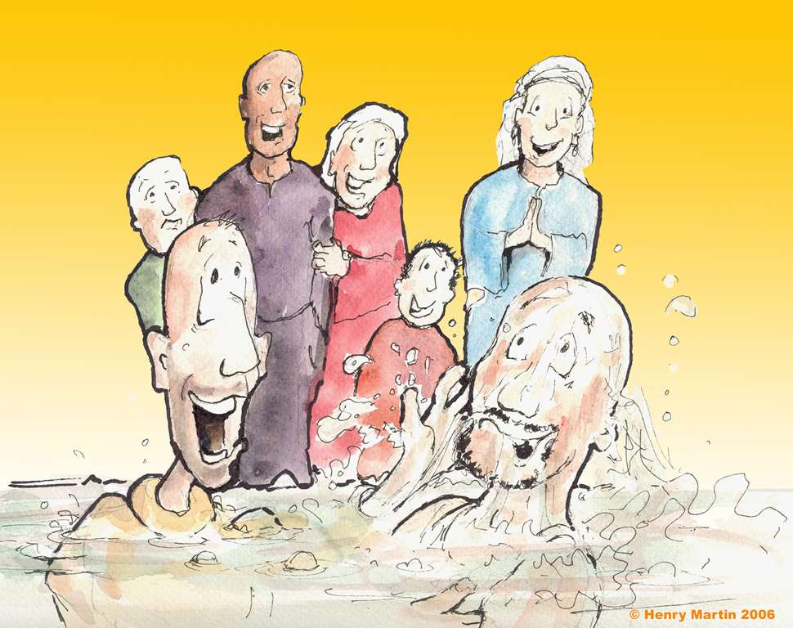
Immersing the jailow
Notes:
Or immersion!

Slide 26
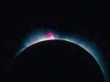
Jesus has always been God
68
"In the beginning
was the Word,
and the Word was with God,
and the Word was God"
(John 1:1)

Slide 27

God became man in Jesus
68
"So the Word became human and lived here on earth among us. He was full of unfailing love and faithfulness. And we have seen his glory, the glory of the only Son of the Father" (John 1:14 NLT)

Slide 28
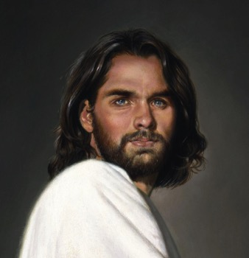
1st century belief in Deity
68
Paul:
"Christ, who is God over all"
Rom. 9:5
Peter:
"God and Savior Jesus Christ"
2 Pet. 1:1
The Father:
"About the Son He says, 'Your throne, O God…'" Heb. 1:8
Jesus:
"I and the Father are one"
John 10:30
Notes:
There is NO doubt that the earliest Christians believed that Jesus was God! Hebrews 1:8 gives us the witness of the Father himself, and where can one find a more reliable witness than God himself?

Slide 29
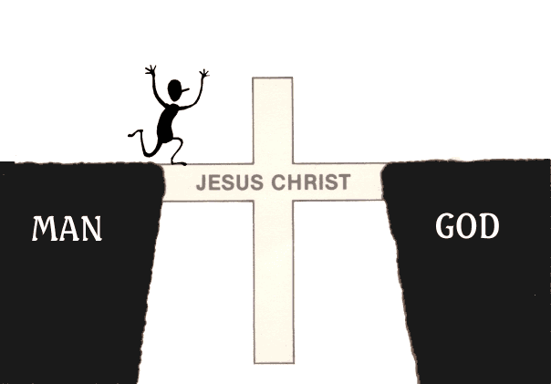
The Gospel is…
GOOD NEWS!
JESUS CHRIST
MAN
GOD
Notes:
NS-26-Jude-40
SA-16-Nature of the Gospel-21

Slide 30
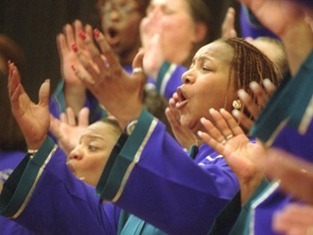
What's the Gospel?

Slide 31
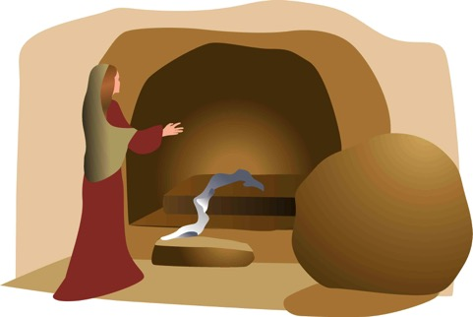
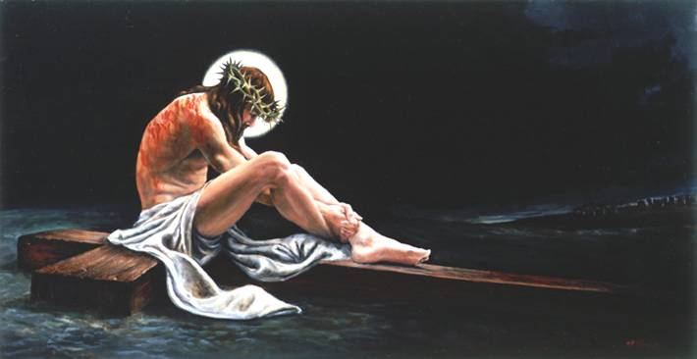
The Full Gospel
68
"Let me now remind you… of the Good News [Gospel]
I preached to you before…" (NLT)
Burial
Risen
Death
"Christ died for our sins…"
"He was raised from the dead on the third day…"
"He was buried…"
1 Cor. 15:3-4

Slide 32

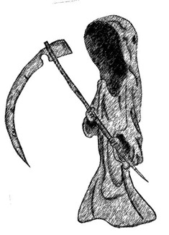
What's the Difference?
Dead
Buddha
Mohammed
Marx
Alive

Slide 33
What's the Difference?
“He was seen by Peter and then by the Twelve. ⁶After that, he was seen by more than 500 of his followers at one time, most of whom are still alive, though some have died. ⁷Then he was seen by James and later by all the apostles.”
Dead
Jesus
Alive
Buddha
Mohammed
Marx
1 Cor. 15:5-7

Slide 34
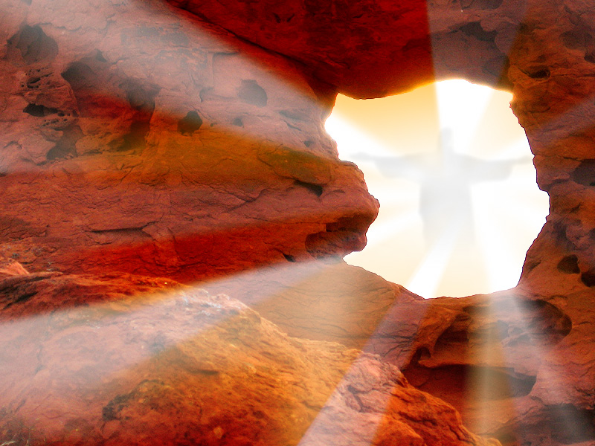
THE RISEN CHRIST
Do you share…
?

Slide 35
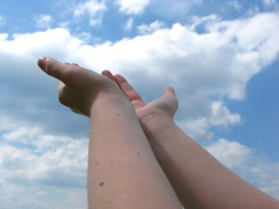
WE NEED TO ATTAIN GOD'S RIGHTEOUSNESS—BUT HOW?

Slide 36

Righteousness in Romans
God's Righteousness by Justification by Faith in Christ––Not the Law
Chapters 1–11 | Chapters 12–16
Righteousness Explained | Righteousness Applied
Theological | Practical
What to Believe | How to Behave
Vertical | Horizontal
Relationship to God | Relationship to Others

Slide 37


"It is finished"
Justification (3:24)
God's act of declaring us "not guilty" for our sins, making us right with him
Legal
Justice (3:25-26)
The fairness of God where He punishes sin in an individual himself or in a Sinless Substitute (Jesus Christ)
Paid
in Full

Slide 38
What must you share to have a clear gospel presentation?
72-73
Faith alone in Christ alone
Our Problem
1. We have sinned against a holy God
2. Our sin deserves death
God's Solution
3. God became man in Jesus Christ
4. Jesus was our substitute on the cross
Our Responsibility is one:
5. Believe (trust, have faith) in Christ's death, burial and resurrection to forgive your sin

Slide 39
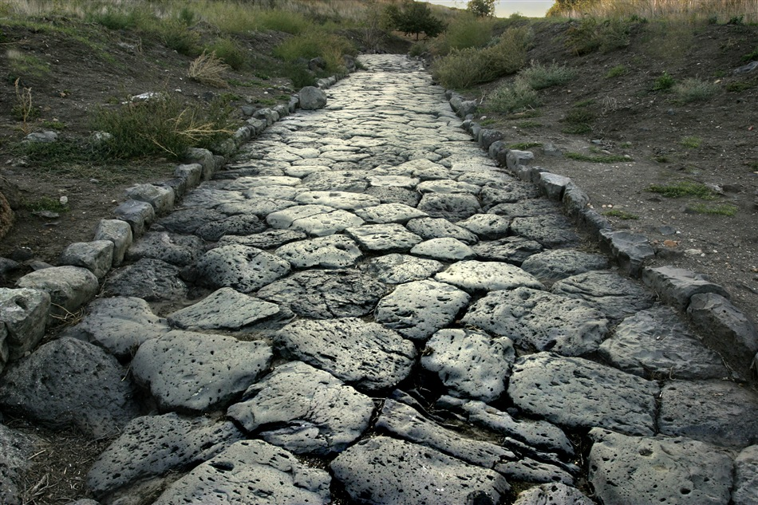
The Roman Road
56

Slide 40
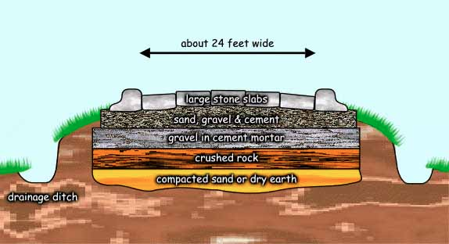
The Roman Road
56
About 24 feet wide
Large stone slabs
Sand, gravel & cement
Gravel in cement mortar
Crushed rock
Compacted sand or dry earth
Drainage ditch
Notes:
NS-Rom3-4-Slide58
SA-16-Nature of Gospel-39

Slide 41
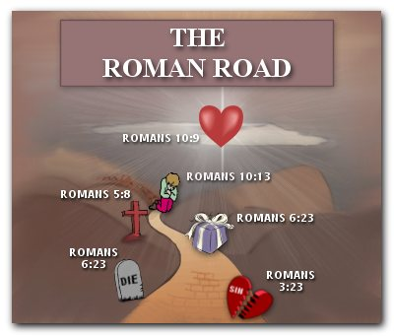
The Roman Road
56
Romans 10:9
Romans 10:13
Romans 5:8
Romans 6:23
Romans
6:23
Romans 3:23
Notes:
NS-Rom3-4-Slide59
SA-16-Nature of Gospel-40

Slide 42
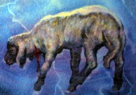
The Roman Road
56
151i
Rom. 3:23
Everyone has sinned.
Rom. 6:23
The penalty for our sin is death.
Rom. 5:8
Jesus Christ died for sin.
Rom. 10:8-10
To be forgiven for our sin, we must believe and confess Jesus as Lord.

Slide 43
What must you share to have a clear gospel presentation?
72-73
Faith alone in Christ alone
Our Problem
1. We have sinned against a holy God
2. Our sin deserves death
God's Solution
3. God became man in Jesus Christ
4. Jesus was our substitute on the cross
Our Responsibility is one:
5. Believe (trust, have faith) in Christ's death, burial and resurrection to forgive your sin

Slide 44
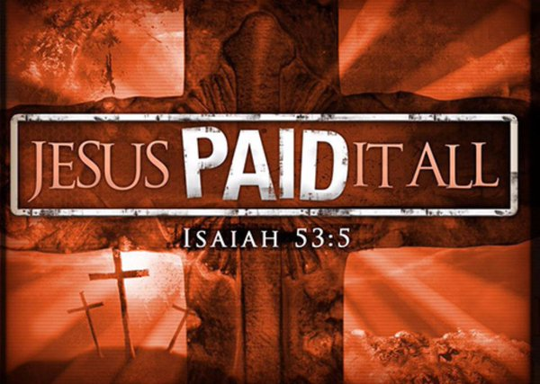
Substitution View
50
JESUS PAID IT ALL
Isaiah 53:5

Slide 45
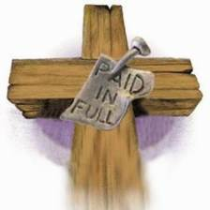
Penal Substitution
50
"Christ the sinless One took on Himself the penalty that should have been borne by man and others"
—Ryrie, Basic Theology, 356

Slide 46

Jesus' death paid for our sin

Slide 47
Tell them.

Slide 48
Black

Slide 49


Salvation link at BibleStudyDownloads.org
Get this presentation and script for free!

